Slide 1
Principal Component Analysis

Slide 2
3 techniques for dimensionality reduction
1) PCA
2) SVD
3) LDA

Slide 3
What is PCA?
PCA is the Dimensionality Reduction technique.
Dimensionality reduction is simply, the process of reducing the COLUMNS/FEATURES.
Dimensionality reduction is the transformation of data from a high-dimensional space into a low-dimensional space so that the low-dimensional representation retains some meaningful properties of the original data.
In Sklearn PCA is Linear dimensionality reduction using Singular Value Decomposition(SVD) of the data to a lower dimensional space.

Slide 4
Why PCA?
A dataset with a large number of attributes, generally of the order of hundred or more, is referred to as high dimensional data.
As the number of features increases, the model becomes more complex.
A machine learning model that is trained on a large number of features, gets increasingly dependent on the data it was trained on and in- turn overfitted, resulting in poor performance on real data, beating the purpose.
However, after a certain point, the performance of the model will decrease with the increasing number of elements. This phenomenon is often referred to as “The Curse of Dimensionality.”

Slide 5






Slide 6
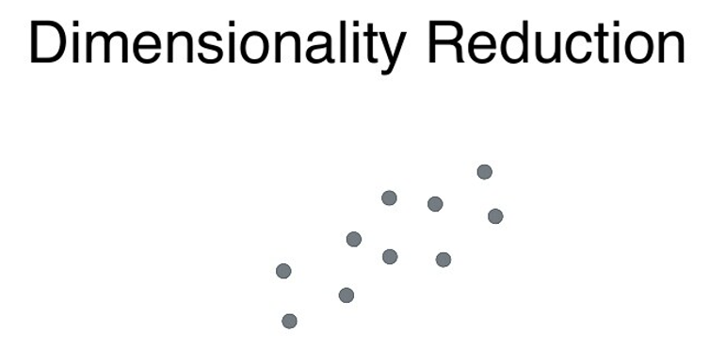

Slide 7
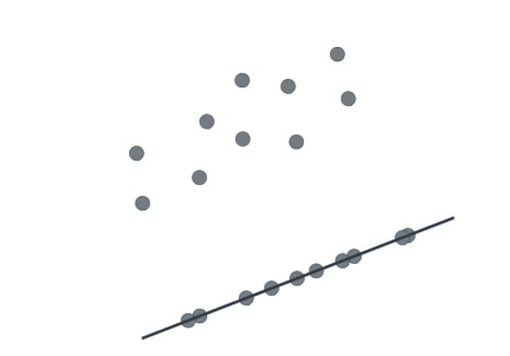
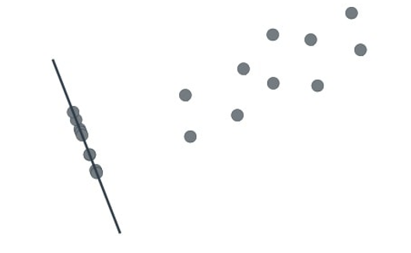
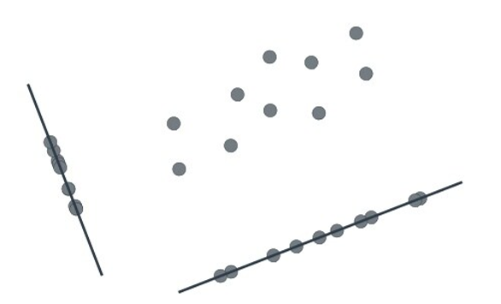

Slide 8
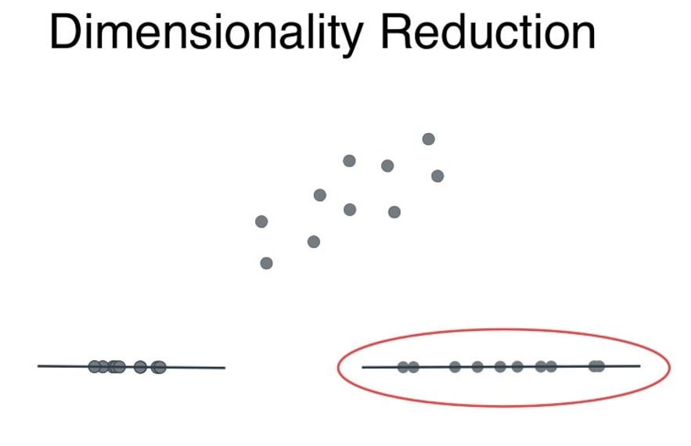

Slide 9
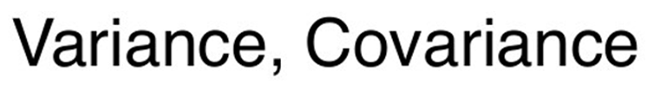
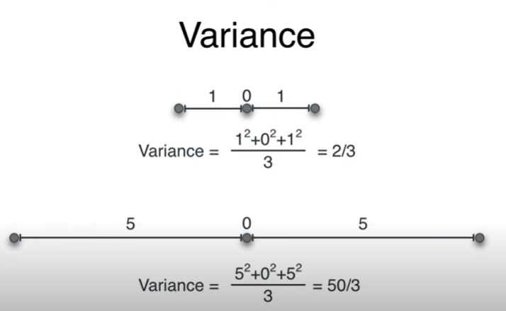
Variance is basically a measure to check how spread out are the points.

Slide 10
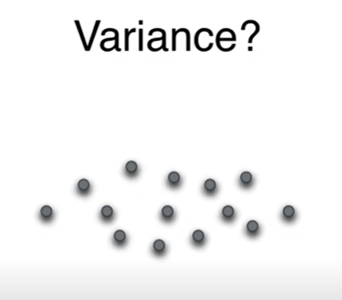
What is the variance for the 2D data?

Slide 11
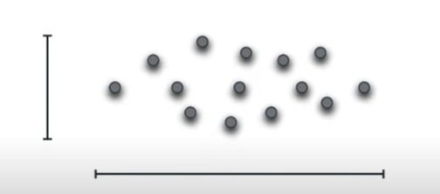
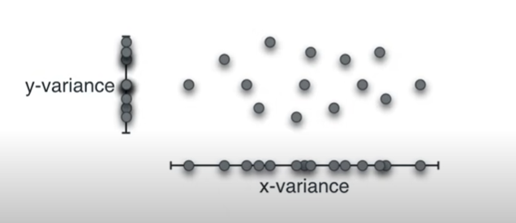

Slide 12
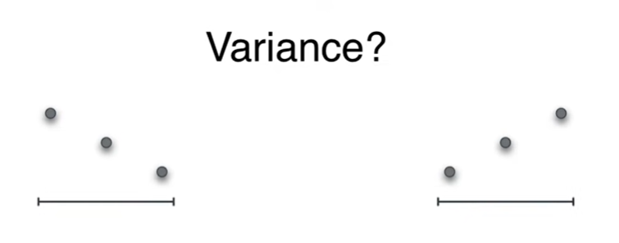

Slide 13
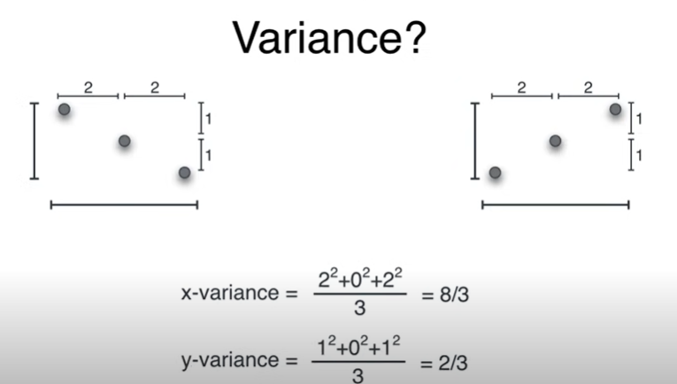
Both the sets have same x-variance and same y-variance but they are fundamentally different.

Slide 14
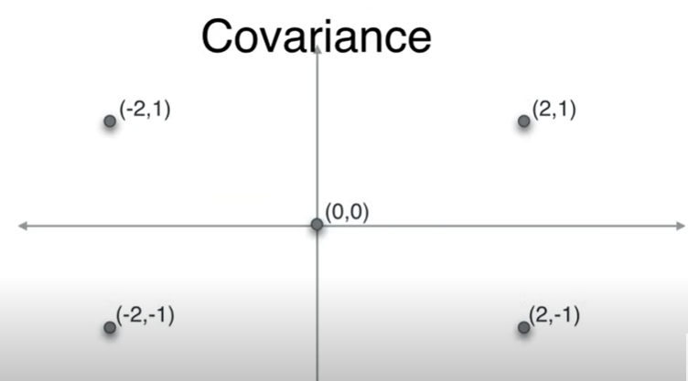

Slide 15
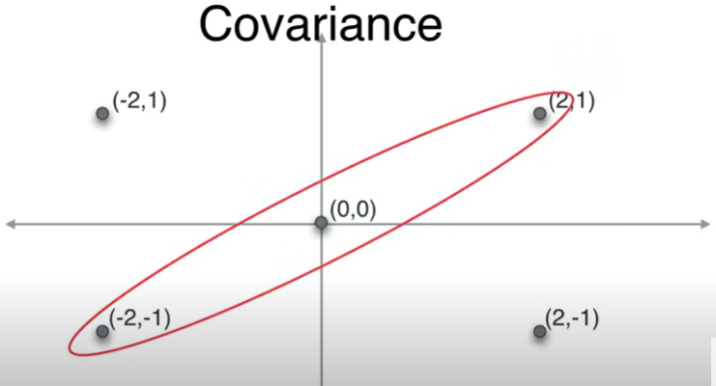
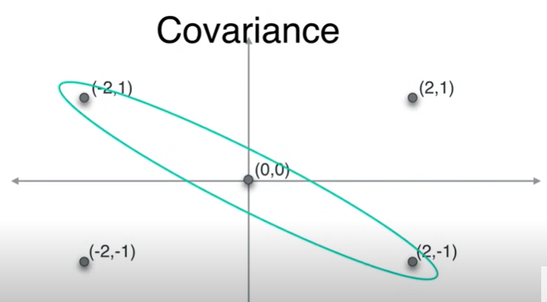
Covariance answers – how red circle points are different from green circled points.

Slide 16
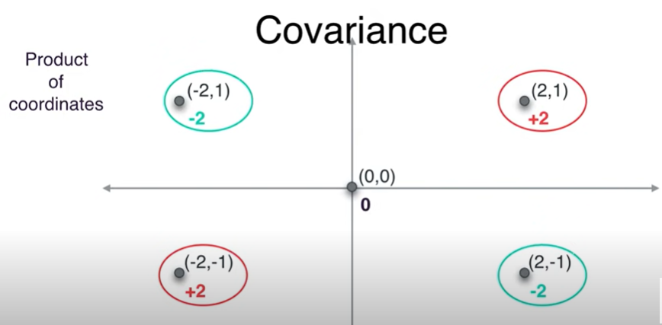
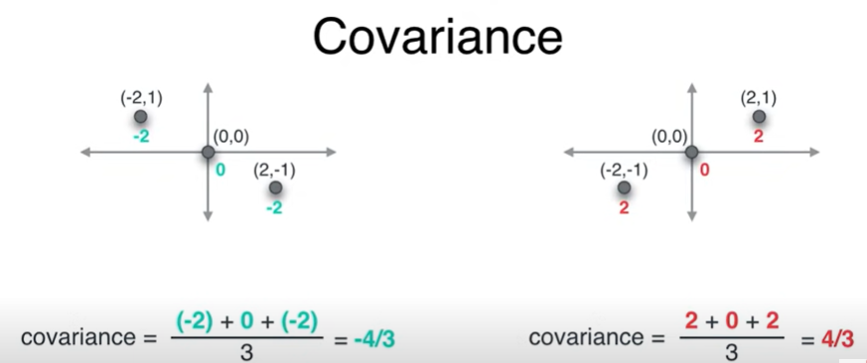

Its Sum of product of co-ordinates.

Slide 17
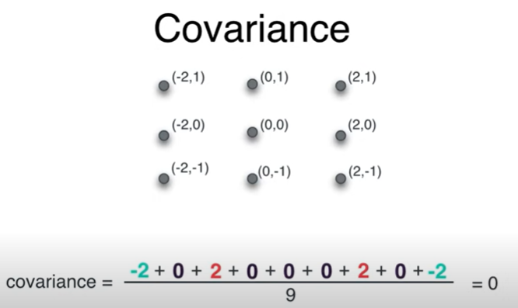

Slide 18
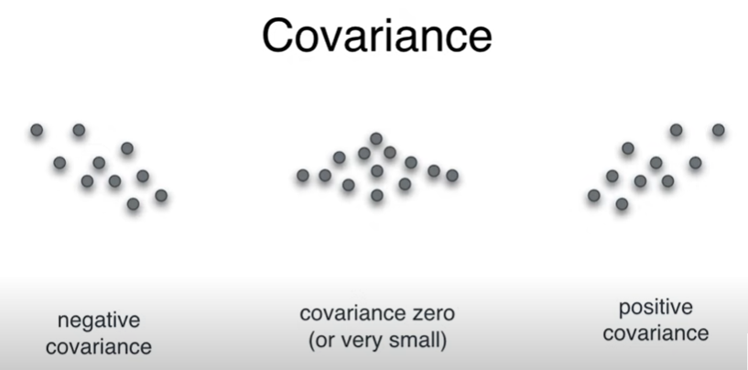

Slide 19
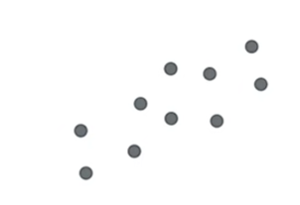
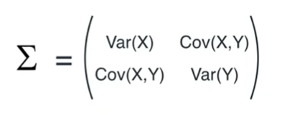
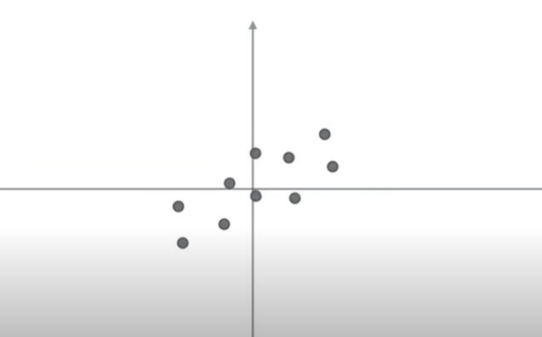
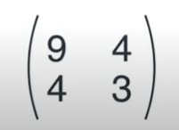
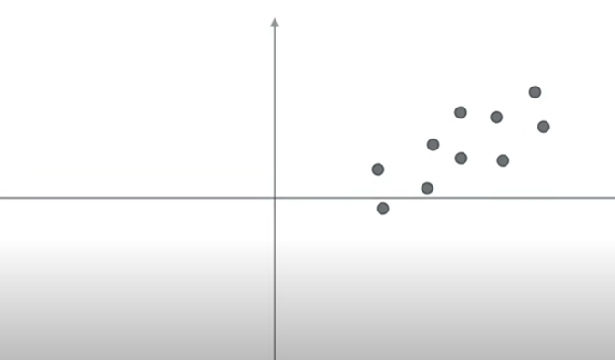

Slide 20
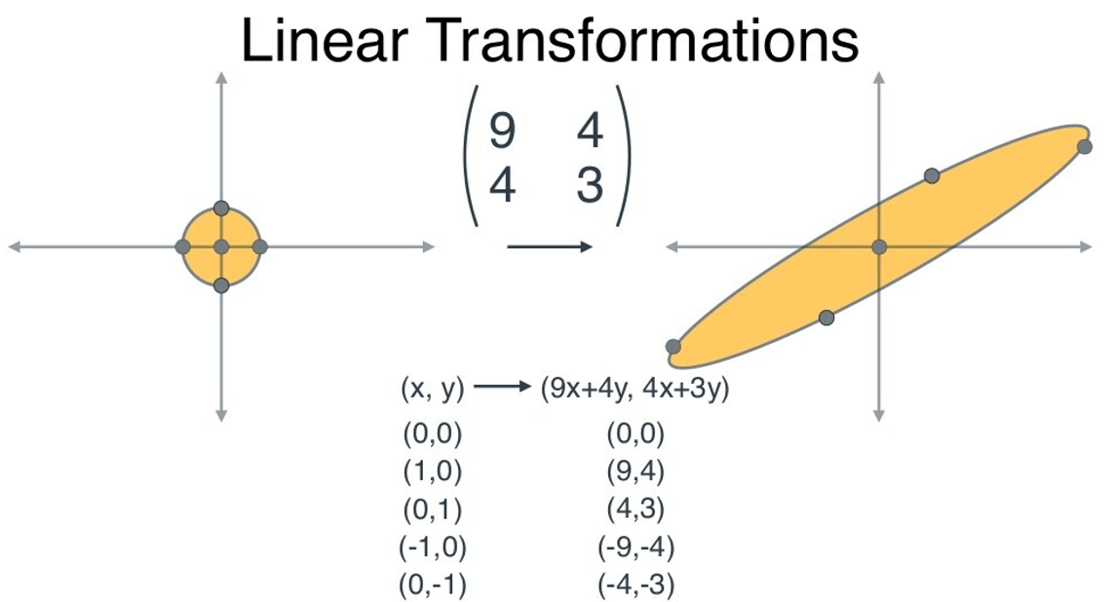

Slide 21
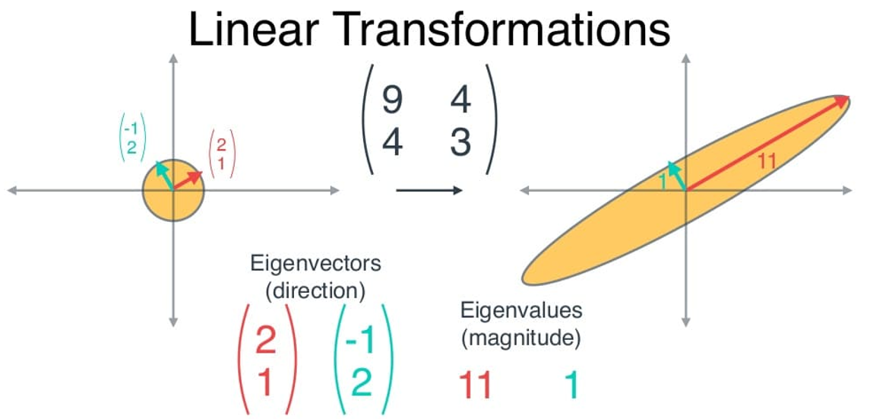

Slide 22
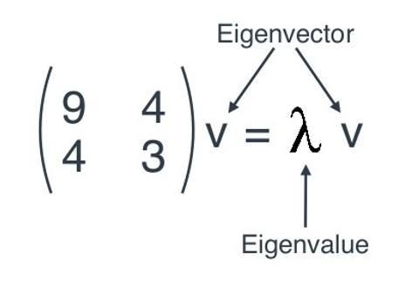
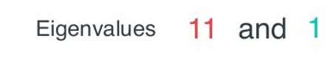
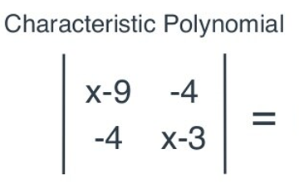
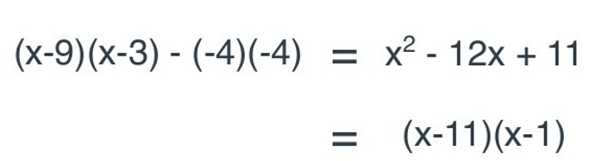

Slide 23

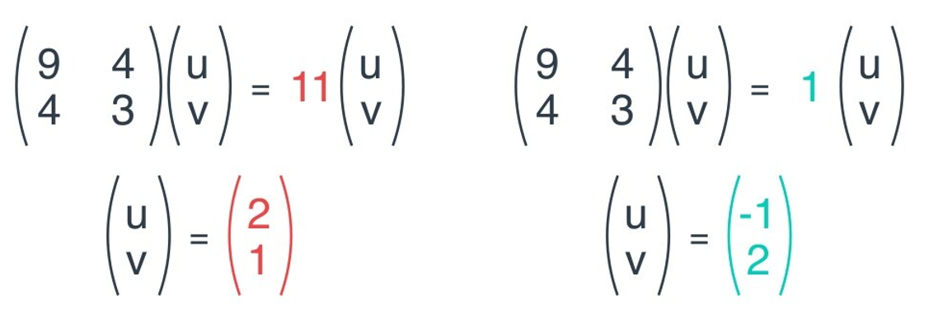

Slide 24
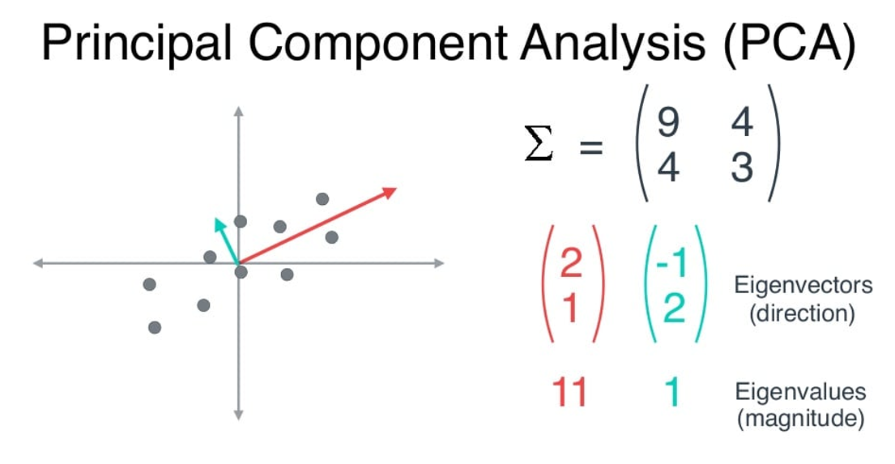

Slide 25
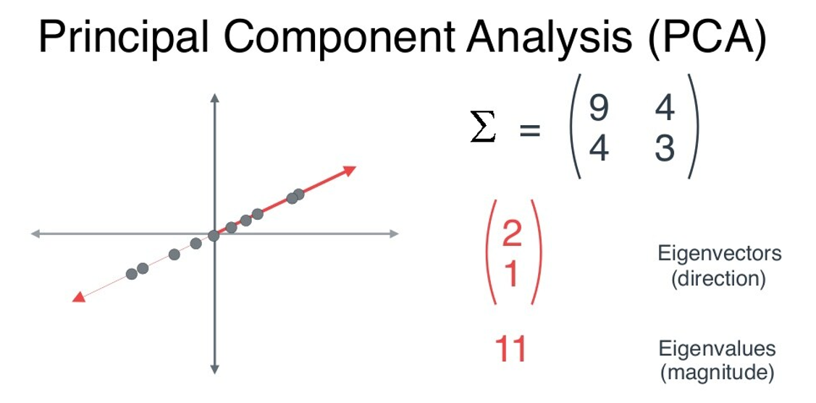

Slide 26
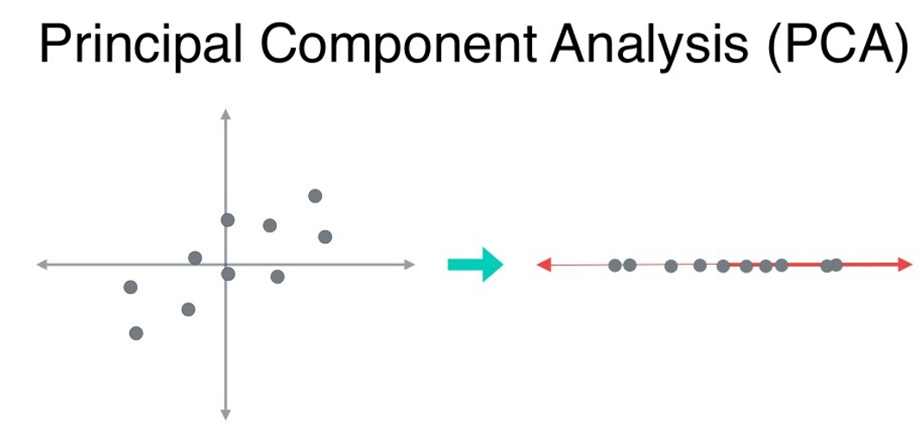

Slide 27
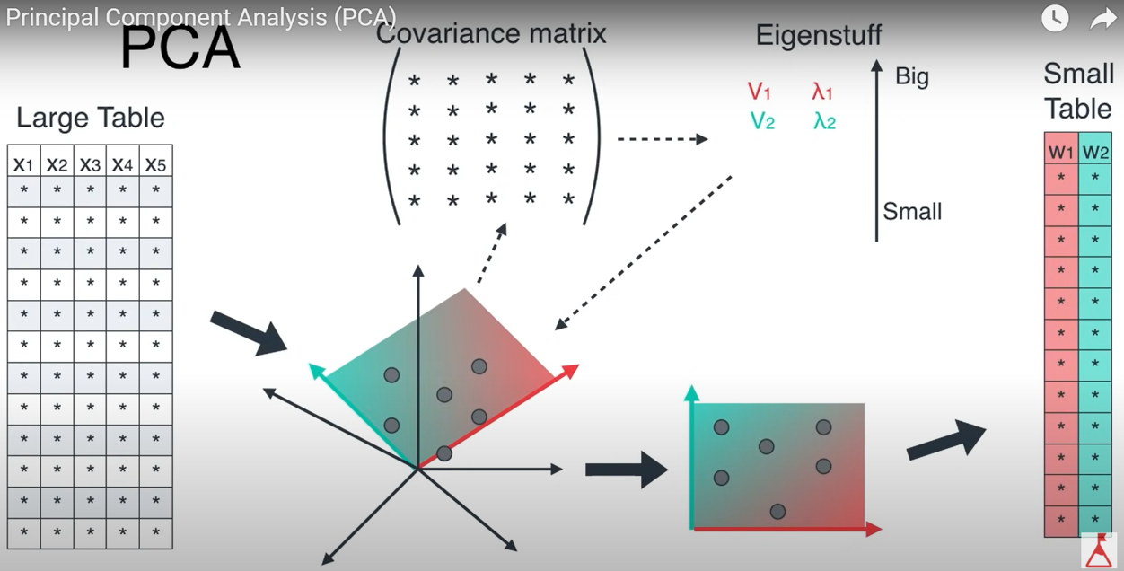

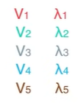
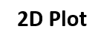
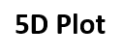
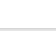

Slide 28

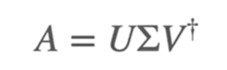
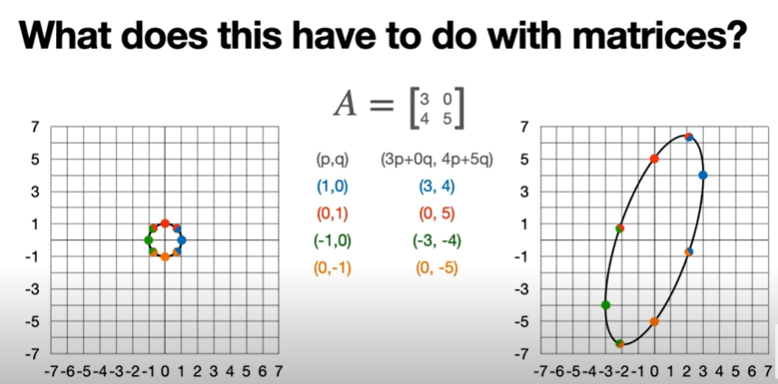

Slide 29

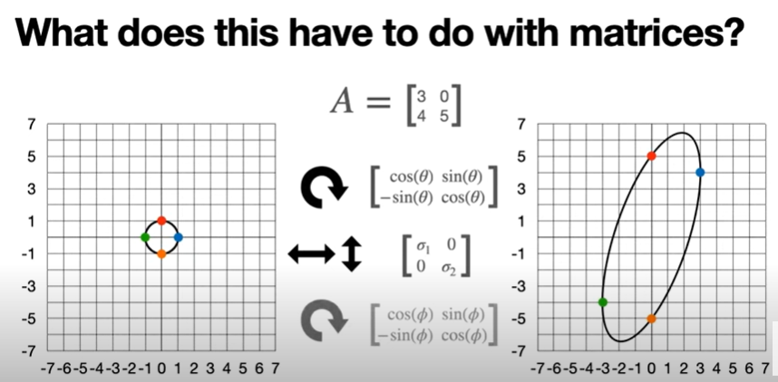
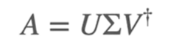
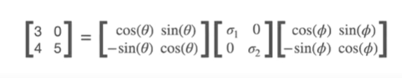
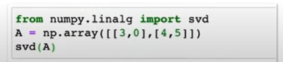
[Rotation Matrix] [Scaling Matrix] and [Rotation Matrix]

Slide 30
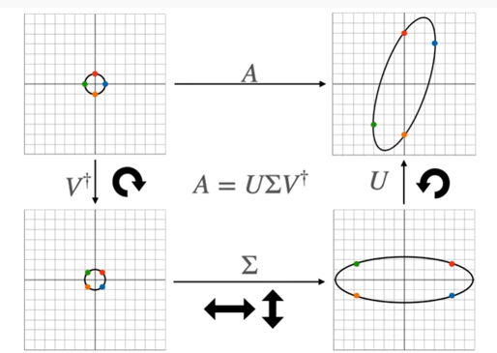

Slide 31
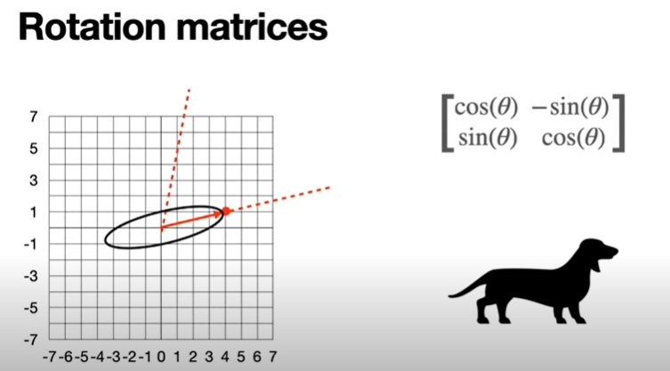
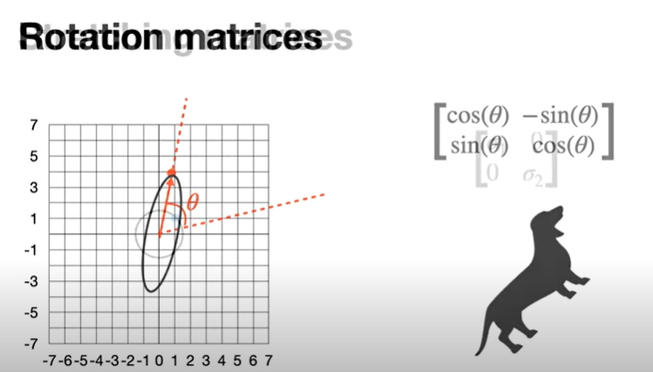

Slide 32
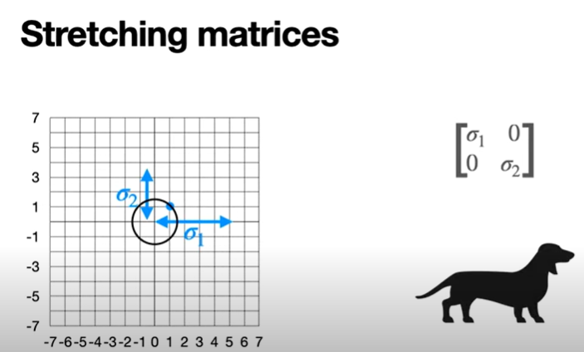
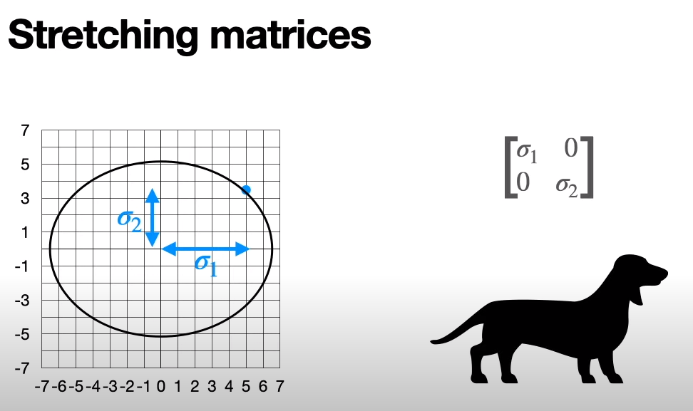

Slide 33


Example
MNIST Dataset
How many features does MNIST dataset includes?
Each pixel is a feature -(28*28) number of features for each image.
Border feature had no importance and could be ignored
Also, neighbouring pixels are highly correlated
Neighbouring pixels can be merged into one without losing much of information
Hence, further reducing the dimensions or features
Border data (features) can be ignored for all datasets

Slide 34



Import Libraries
Load the MNIST Data

Slide 35


Split Data into Training and Test Set

Slide 36




Apply PCA
The amount of variance explained by each of the selected components.

Slide 37



Slide 38





Slide 39



